Slide 1
Nano-Material and Nano-Technology In Geotechnical Application
Jasim M Abbas, PHD
College of Engineering
Dep. of Civil Engineering
Diyala University
2017

Slide 2
Outlines
Nano-material
Used for soil improvement
Nano-technology
Used for soil investigation

Slide 3
PART 1
Soil Improvement

Slide 5
Nanomaterial (NM):
Nano-sized material having at least one external dimension in the size range of 1-100 nanometers.
NMs include nanoparticles (NPs), nanostructured materials and ultrafine particles, and their agglomerates and aggregates

Slide 6
Soil Improvement
In most practical situation, the soils are treating and improving its strength parameters during the construction of the most geotechnical projects
There is little information in the geotechnical literature regarding the influence of the nano-material additive on the engineering behavior of soils.
Therefore????
More information (Knowledge)
More practices
More believe

Slide 7
Soil Improvement
One of the most common techniques is soil stabilization with additives or admixtures.
In this technique
the geotechnical properties of soil is enhanced by mixing it with another material.
include cement, lime, calcium chloride, fly ash, bitumen, etc.
for soft clays and peaty deposits which are composed of fine particles with high moisture content, granular materials such as sand and industry by-products have also been used.
Mixing these additives in the ground served the following purposes:
strength increase,
deformability/settlement reduction,
volumetric stability (control of shrinking and swelling),
reduction of permeability,

Slide 8
Soil Improvement
IMPORTANT
the fundamental requirement for civil engineering projects is that it must be inexpensive.
land to be improve covers a huge area and also involving large distances (for example highways).
Thus
the need to keep the project economical (low cost materials).
In order to meet this requirement, industrial by-products or waste have also been extensively studied.
However,
these raised another important question, i.e. toxicity of the materials. Leaching of toxic chemicals to the environment posed health related issues and are therefore another basic requirement for candidate materials for soil improvement.

Slide 9
Soil Improvement
The nano-soil is actually a product of milling of a natural soil in which a greater portion of its particles was pulverized into nano sizes (1-100 nm).
The use of such materials almost entirely eliminates the toxicity questions, as usually raised for nanomaterials applications, since the material to be used is originally a natural soil.
Much studies have been conducted and documented on the use of nanoparticles or nanotechnology in conceivably all fields of knowledge except geotechnical engineering.
Although it is possible to speculate the general properties of soil when nanoparticles are added but real data are lacking due to inexistence of such research.
pave the way to more extensive research on nanotechnology and nanoparticles in geotechnical engineering.

Slide 10
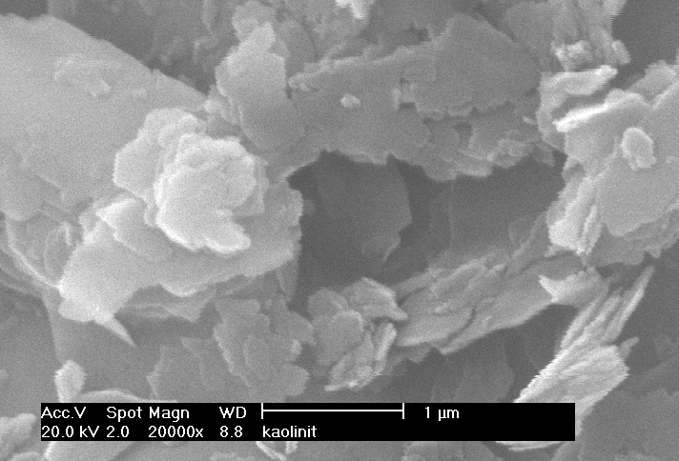
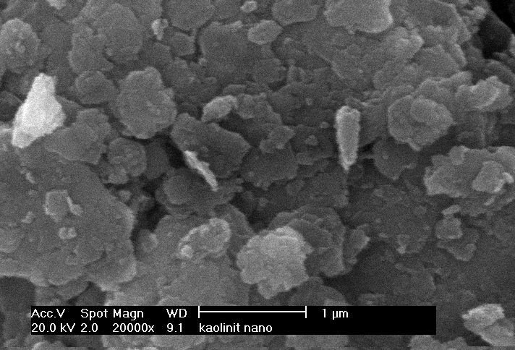

Slide 11
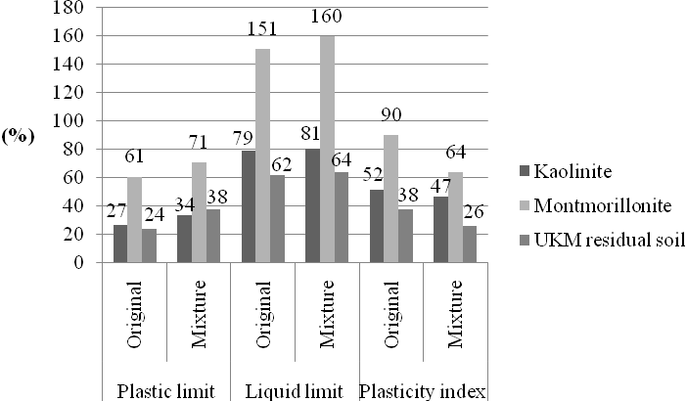
Case study

Slide 12
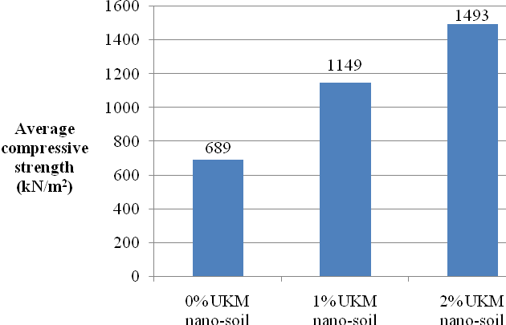

Slide 16
Polymer Nanocomposite Reduces Atterberg Limits Polymer nanocomposite reduced Atterberg limits of CH clay …… Increase soil strength

Slide 17
Polymer Nanocomposite Improves Compaction

Slide 18
Polymer Nanocomposite Increases Shear Strength

Slide 19
Polymer Nanocomposite Reduces Volumetric Shrinkage

Slide 20
Challenges of Using Nanomaterials for Soil Improvement
•COST of nanomaterials is high
•Potential environmental and health risks of nanomaterials

Slide 21
PART 2
Soil Investigations

Slide 22
Nanotechnology: Nanotechnology is a multidisciplinary science and technology and encompasses physical, chemical, biological, engineering and electronic processes.

Slide 23
Soil Investigations
The soil investigation is one of the important element during any civil engineering project construction, and it is includes
Site investigation
Soil and rock studies
Study of water table
Then, analyze of all important data used to estimate the soil behavior before (design), during the construction and after period of time

Slide 24
Soil Investigations
Divided into to stages
Primary investigation report
Final investigation report
Depend in the important of each project

Slide 25
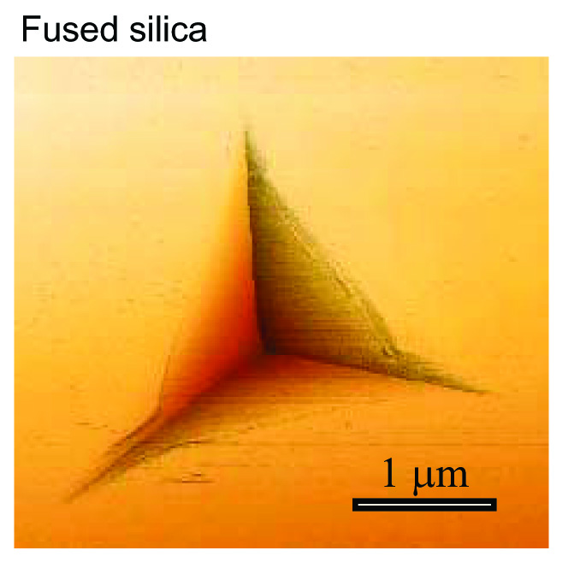
Soil Investigations
Nano-indentation
is a simple non-destructive test
used to measure, the elastic modulus and hardness of small volumes of material such as thin films and bulk specimens.
The technique (also called instrumented indentation) allows measurement of depth versus load curves from which the properties are calculated. New standards defines it ISO14577 and ASTM E2546-07

Slide 26
Soil Investigations
Nano-indentation
An indenter tip (Berkovich, Vickers, Sphero-conical, Knoop or Cube-corner), with a known geometry, is driven into the sample surface with an increasing load up to a preset value.
The load is gradually decreased until partial, or complete, relaxation of the sample occurs. During the test the depth of penetration is measured versus applied load.
The load-displacement result shows the elastic-plastic loading, followed by the elastic unloading.
The elastic equations of contact are then used in conjunction with the unloading data to determine the elastic modulus & hardness of the specimen material.

Slide 27
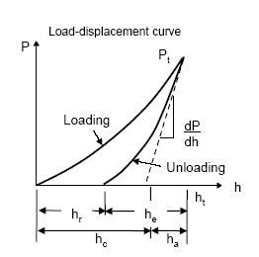
Soil Investigations
Nano-indentation

Slide 28
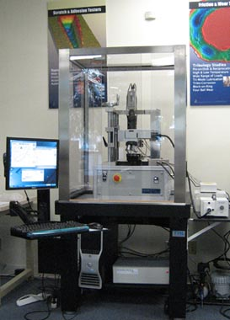

Slide 29
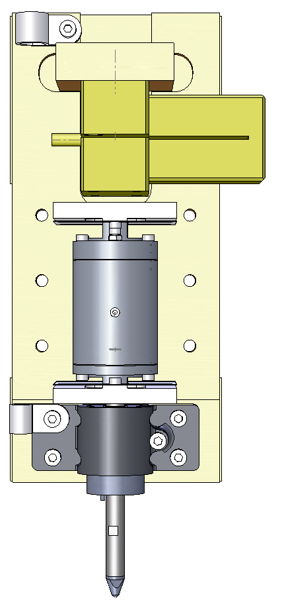
PZT Actuator
Load cell
160 mm
Depth sensor
Indenter

Slide 30
Sustainable Development of Nanotechnology is the Key

Slide 31
Thank You
Dr Jasim Al-Shamary
Jasimalshamary@yahoo.com

